Slide 1

Thesis Topic: Optimizing Distributed Tracing and Telemetry in Microservices Using OpenTelemetry.
Name: Md Nur Mohammad
Masters in Communication systems and Networks at TH Köln
Student ID: 11145131
Supervisor:
EL Hussien Habib
Observability Site Reliability Engineer @Trivago

Slide 2
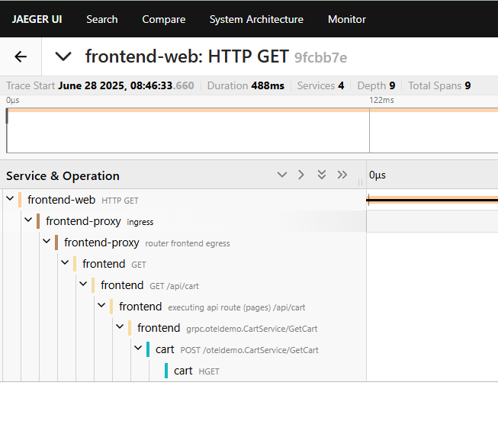

Slide 3
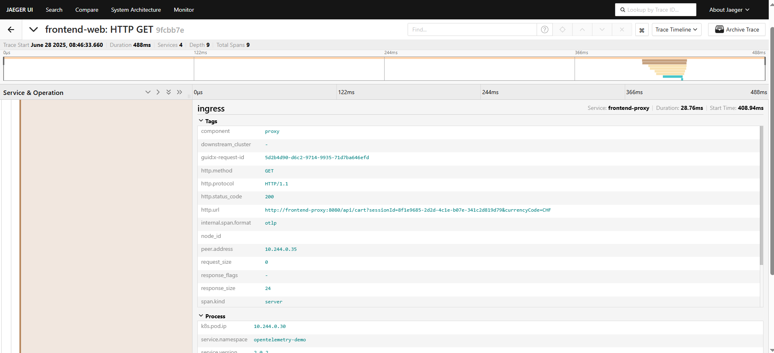

Slide 4
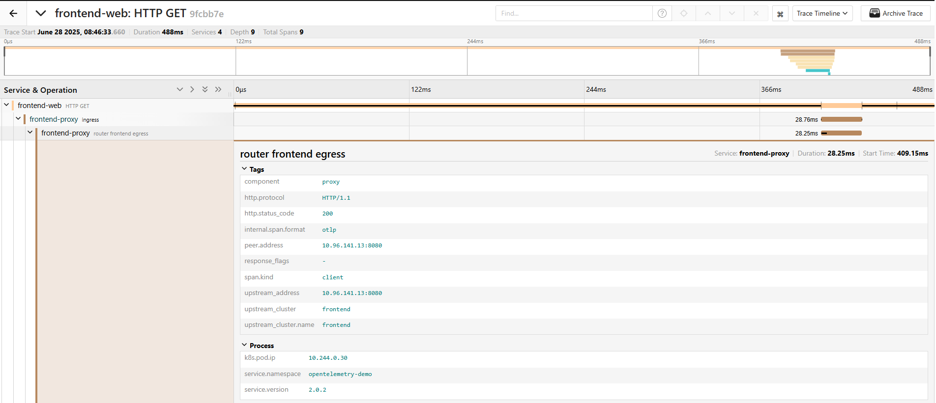

Slide 5
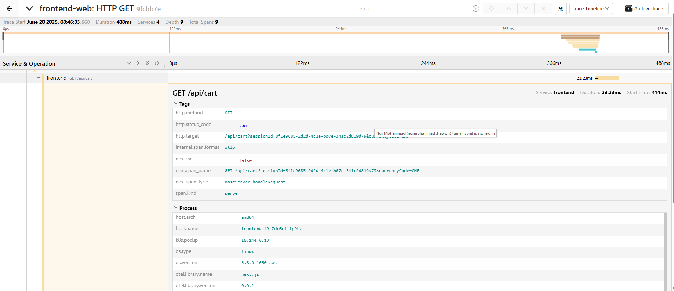

Slide 6
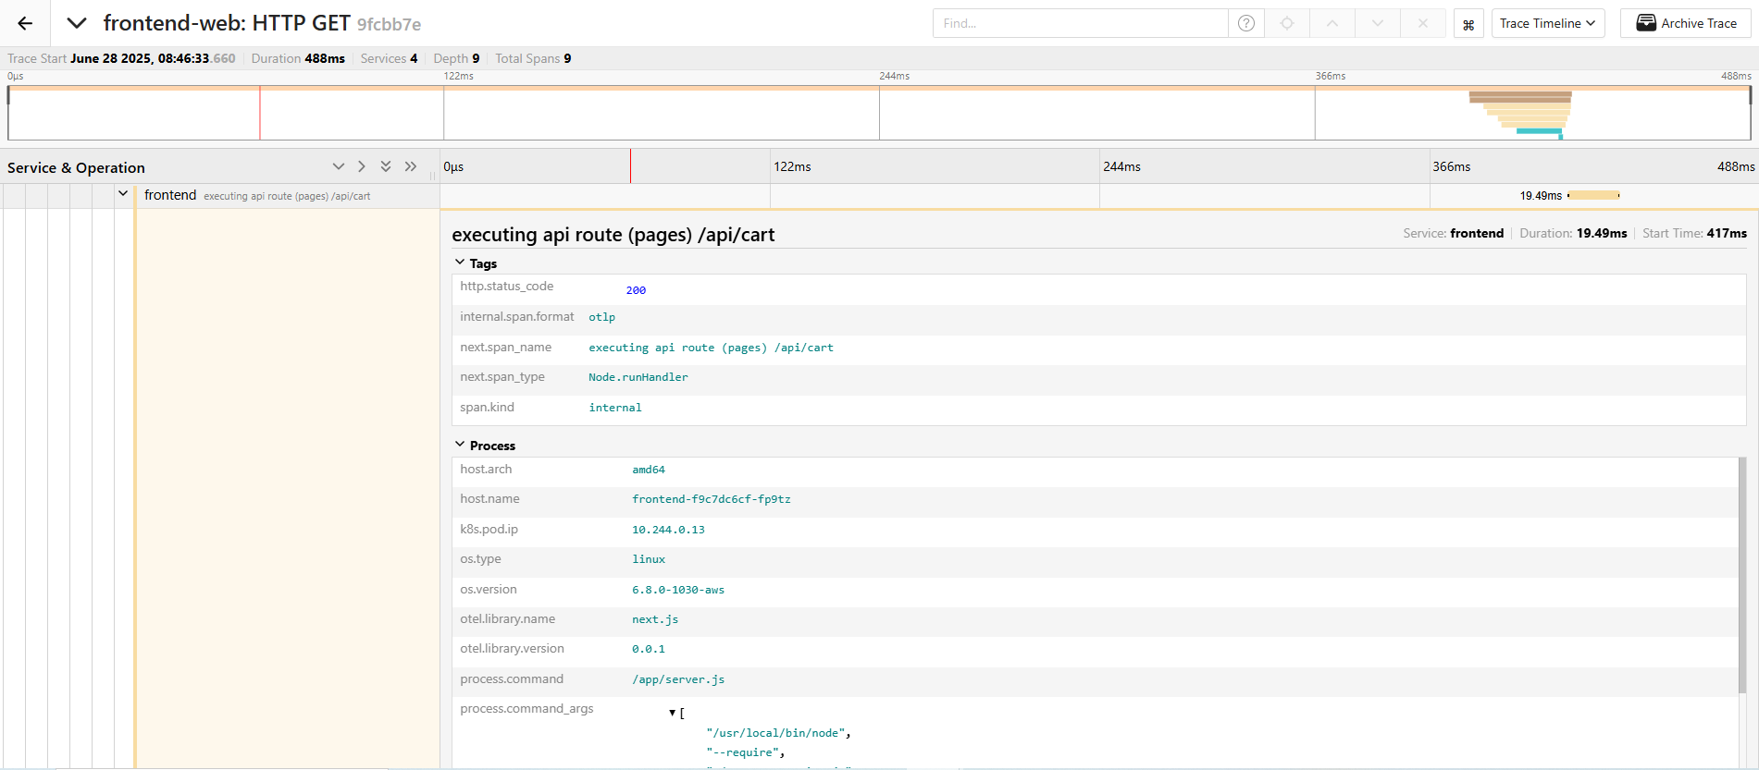

Slide 7
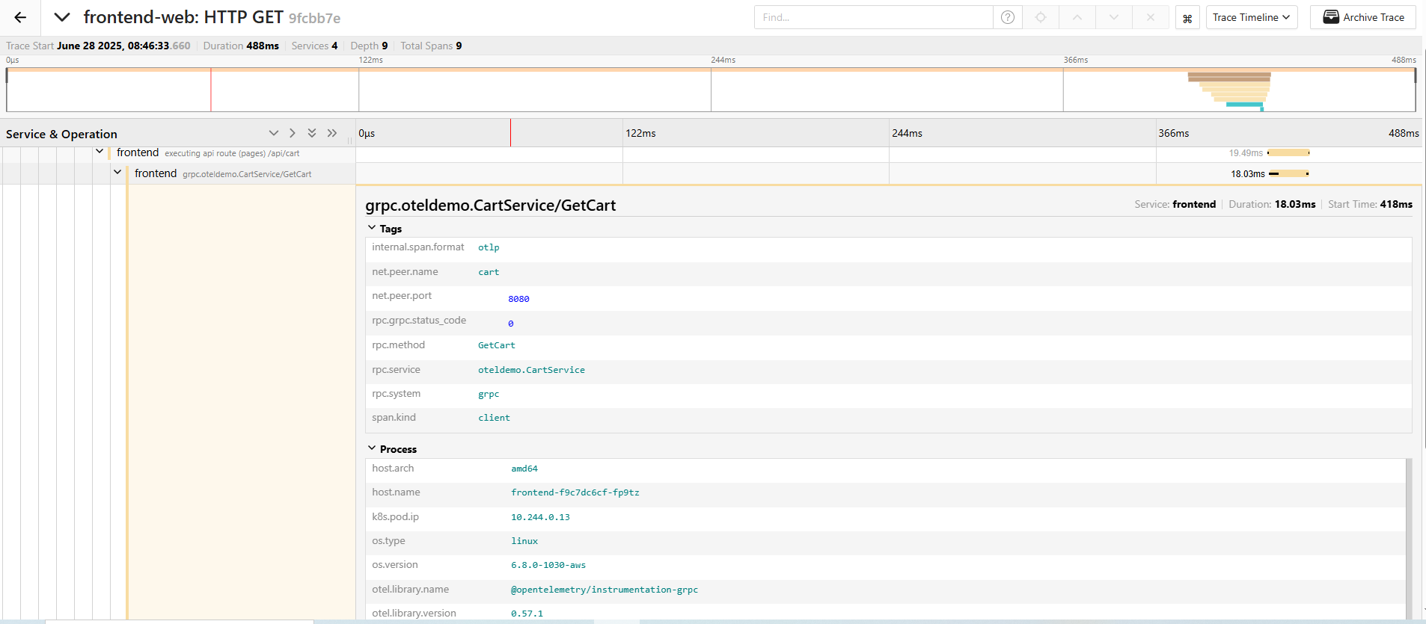

Slide 8
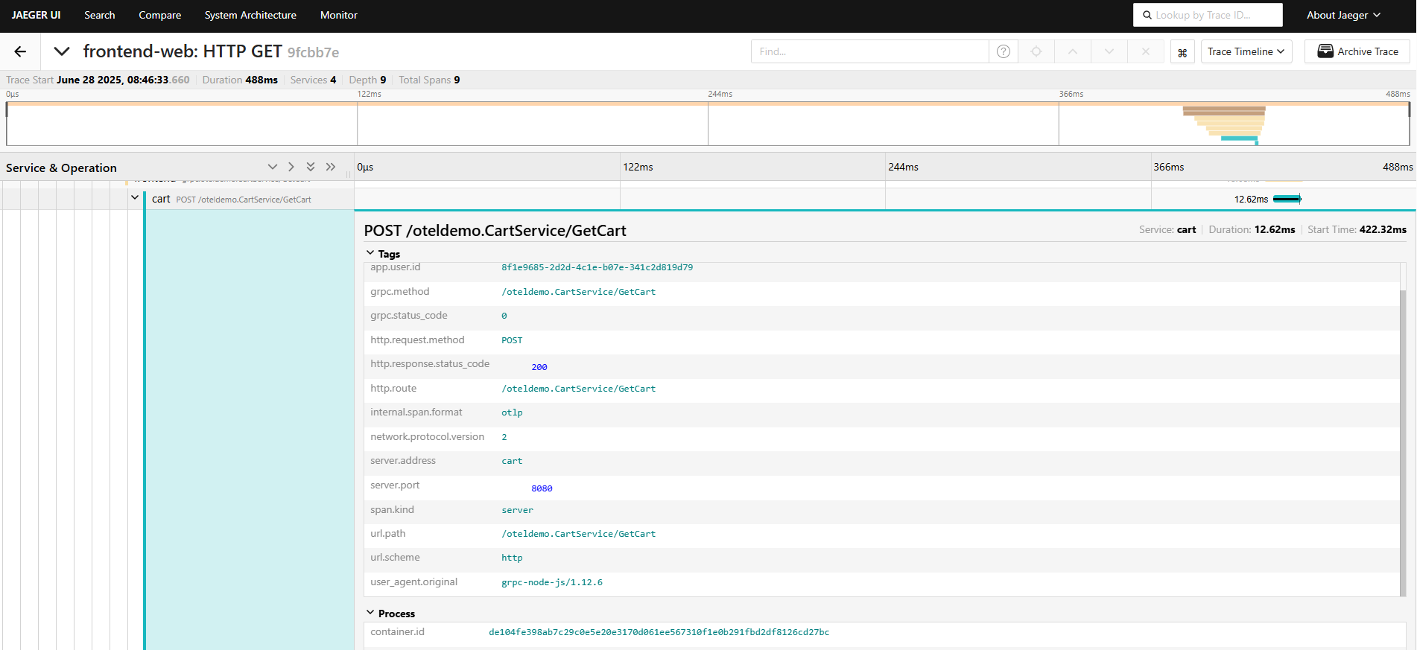

Slide 9
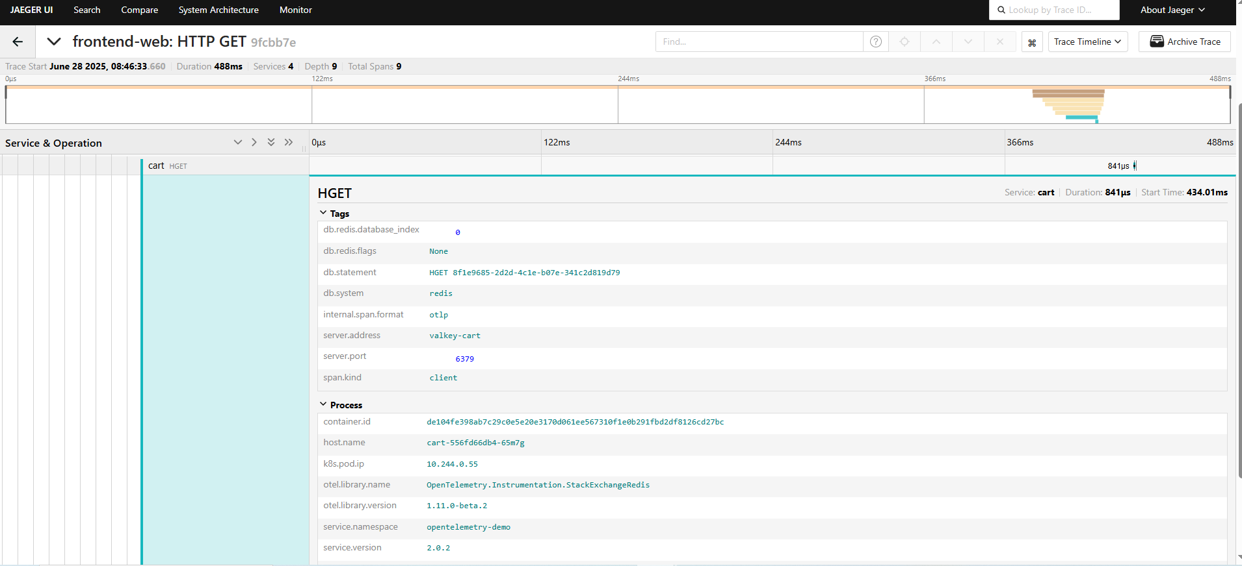

Slide 10
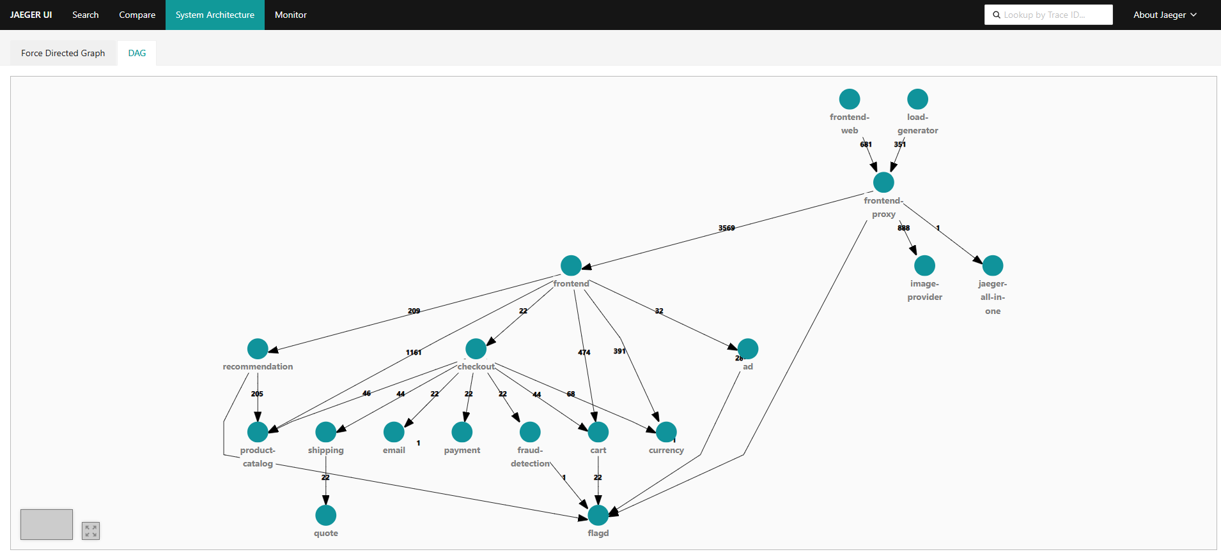

Slide 11
